Slide 1


Statistical ML for Restaurants Income/Rating
Presented by R. Galicia and N. Da Silva
1

Slide 2
Introduction
We will explore how Unsupervised and Supervised Learning can be applied to analyze restaurant data. By leveraging techniques like PCA, classification, and regression , we can uncover patterns and predict restaurant’s income and rating.
Restaurant Data overview
Dataset’s features include various aspects of restaurant operations, including customer accessibility, neighborhood quality, staff training and experience, menu diversity, promotional efforts, pricing strategies, advertising effectiveness, customer satisfaction and loyalty, competitive environment, local economic conditions, and environmental factors.
By the end, you will understand how we developed our statistical model and conducted analysis by leveraging these techniques.
2

Slide 3

Exploratory Data Analysis (EDA) & Feature Selection via Regularization
A brief exploration of the data will be done. Also, we will attempt to narrow down the features depending on the output from regularization
01
02
Principal Component Analysis (PCA) & Association with Income & Rating
Using PCA on high-dimensional data creates principal components that will be beneficial for factor analysis. We will interpret these factors and discover how it associates with Income and Rating
03
Model Building
Discover what is the model that best fits our data and performs the best on unseen/new data
Strategy
04
Conclusion
Final thoughts and key takeaways
3

Slide 4

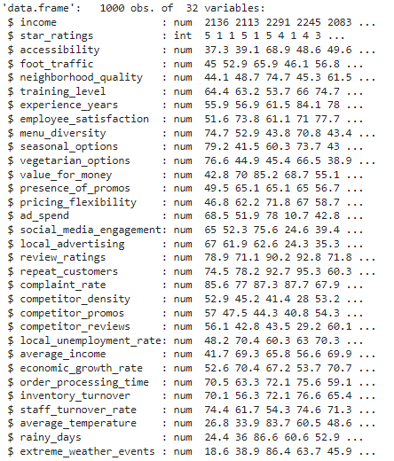
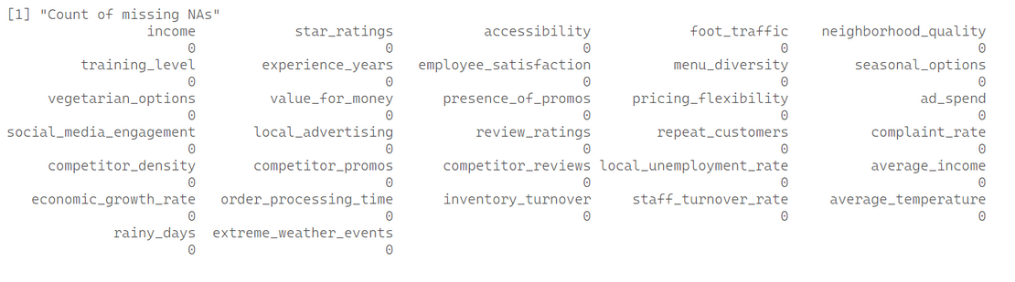
Exploratory Data Analysis
is first conducted to analyze and investigate data sets to then understand their key characteristics, uncover patterns, and identify relationships between variables. The results of the principal component analysis (PCA) will be used in both EDA and model building.
The following shows the EDA results for the restaurant data:
Dataframe Schema
Null Check
4

Slide 5
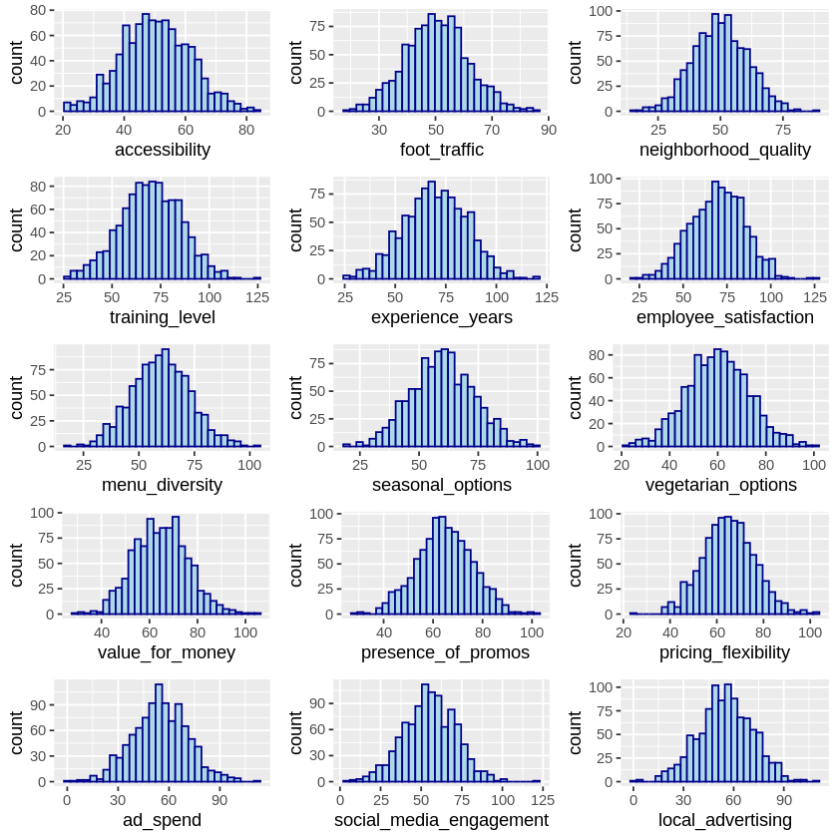
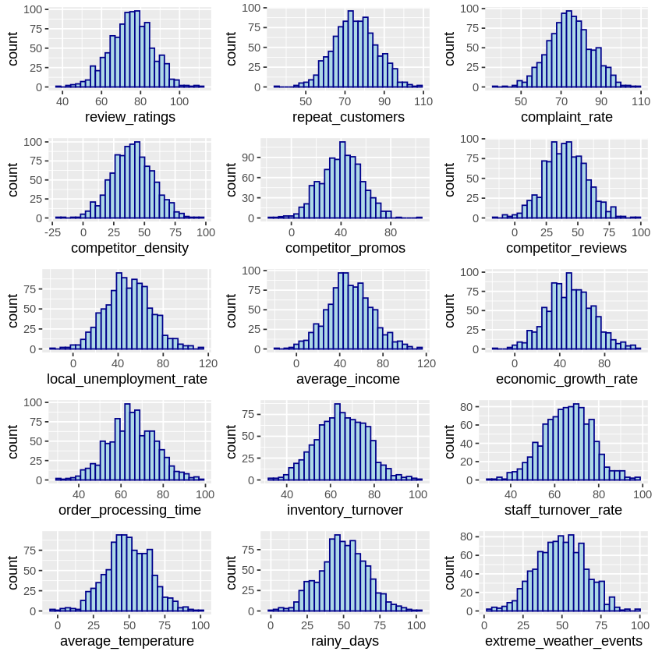
Exploratory Data Analysis
Data Distribution
5

Slide 6
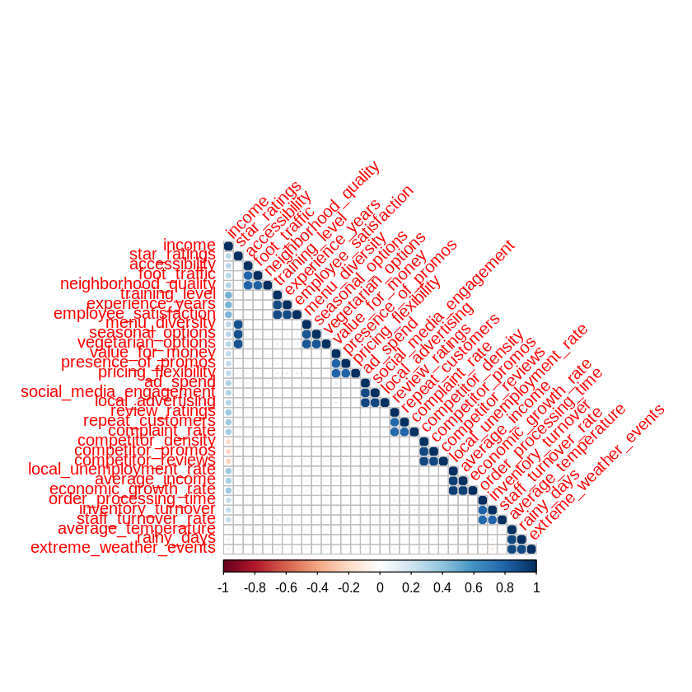
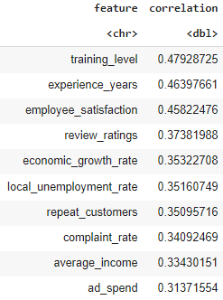
Exploratory Data Analysis
Top 10 Correlated Features (to Income)
Correlation Matrix
6

Slide 7
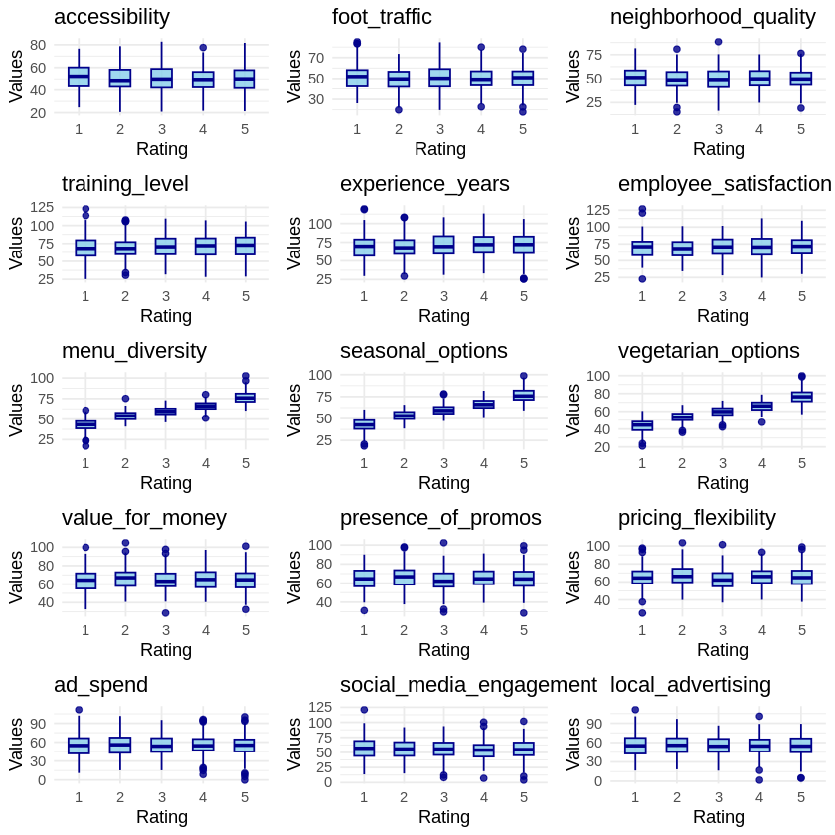
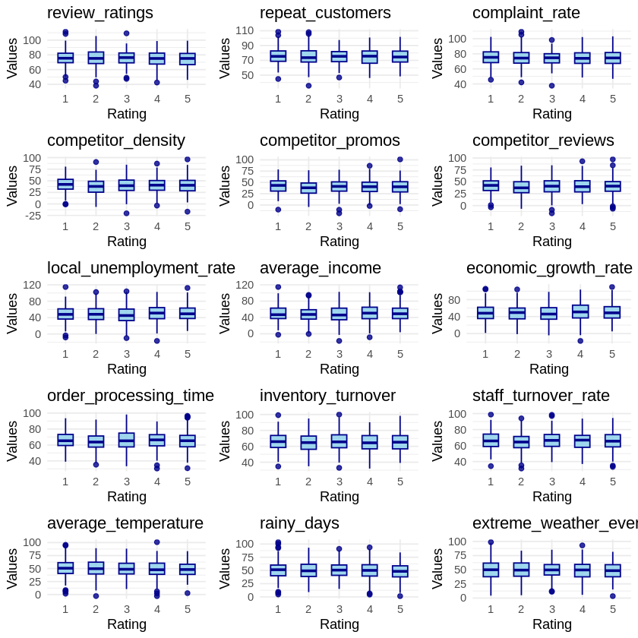
Exploratory Data Analysis
Categorical Plot of All Features vs. Star Rating
7

Slide 8
Exploratory Data Analysis
Insights:
The data frame contains 30 features. Their relationship with the response variables will be evaluated in order to hopefully trim them down if able.
There is no need to clean the data as no nulls were detected for all columns.
All of the features are normally distributed, which is beneficial for most machine learning models (due to the normality assumption)
Multiple features show moderate correlation to the income of a restaurant. This is a good sign since the correlation can help with getting a strong predictive model.
Almost all of the features show no clear pattern vs the star rating of a restaurant. For example, regardless of a restaurant’s star rating, its accessibility is the same in general.
Only menu diversity, seasonal options and the vegetarian options features show some potential with trying to predict the star rating of a restaurant. HOWEVER, we have to consider the possibility of collinearity between the three since they seem to exhibit moderate correlation to each other as well.
8

Slide 9
Exploratory Data Analysis
Based on these insights gained from the EDA, we came up with the following approaches:
Using Feature Selection via Regularization
Train a ridge regression model and get the best fitted model with hyperparameter tuning via cross validation (using the cv.glmnet() function). Extract the coefficients of each feature.
Train a LASSO regression model and get the best fitted model with hyperparameter tuning via cross validation. Extract the coefficients of each feature.
Train an elastic net model and get the best fitted model with hyperparameter tuning via cross validation. Extract the coefficients of each feature.
Compare the cross-validated metric of each regularized models and select the best performing one. The features that have a coefficient greater than 0 will be used for building other models.
Use the regularized models as baseline models for other models to be built.
NOTE: The regularized models will be used both for feature selection and model building, should they have a better performance than the other models to be built.
Using PCA for Dimensionality Reduction for Factor Analysis
Extract the Principal Components from the raw features set.
Select all of the principal components that fall under the 90% cumulative variance ratio (in descending order)
Use the selected principal components for model building, if applicable.
9

Slide 10
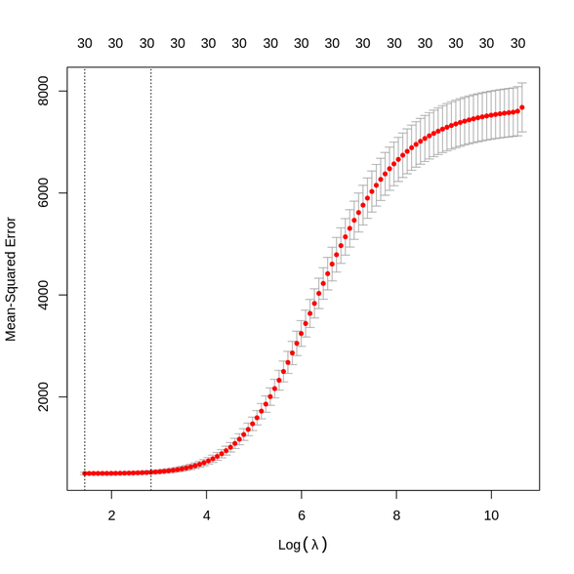
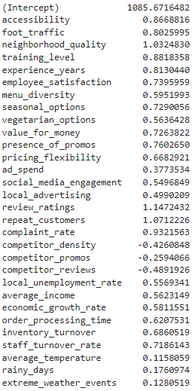
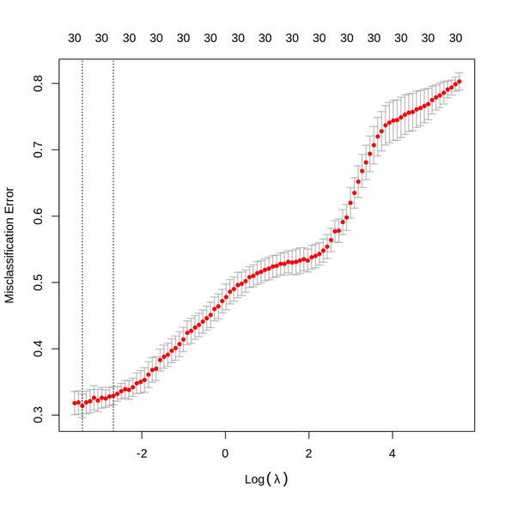
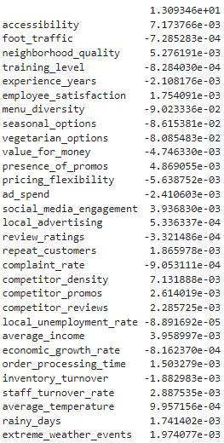
Feature Selection using Regularization
Using regularization, we build a ridge regression model, LASSO regression model and elastic net model. Then, we perform cross validation to get the values of lambda and alpha (for elastic net only) that garner the best performance. The coefficients will then determine which features to keep and to discard.
Ridge Regression - Income
Ridge Regression - Star Rating
Lambda vs MSE Plot
Coefficients
Lambda vs Misclassification Error Plot
Sample Coefficients
10
NOTE: For predicting the star rating, 5 sets of coefficients are created but only a sample is shown for brevity

Slide 11
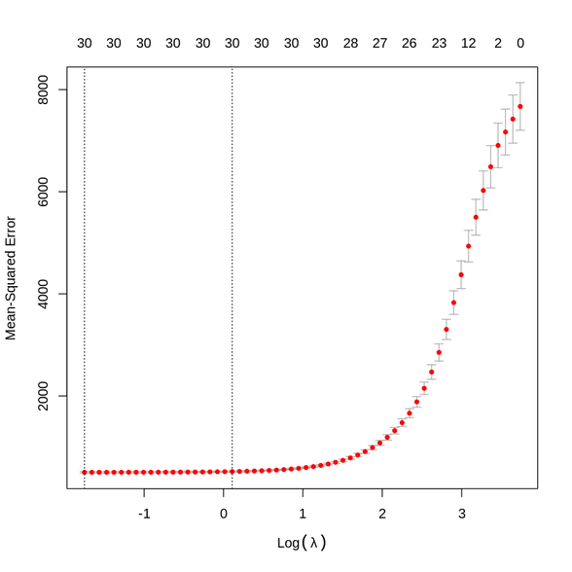
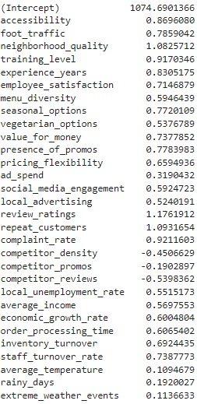
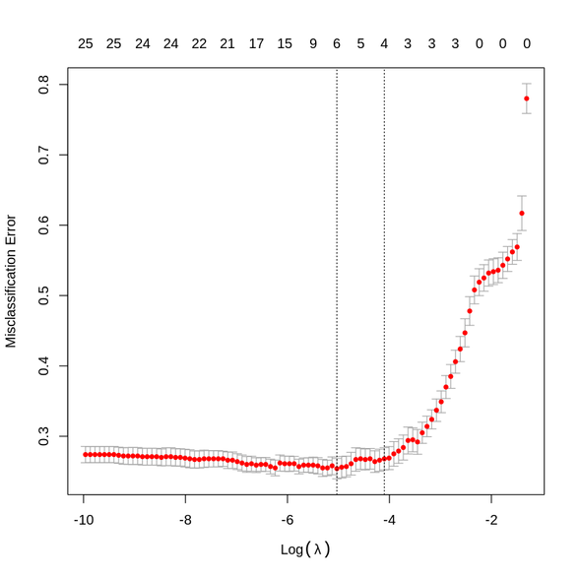
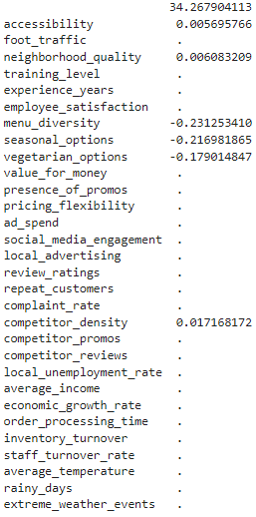
Feature Selection using Regularization
Using regularization, we build a ridge regression model, LASSO regression model and elastic net model. Then, we perform cross validation to get the values of lambda and alpha (for elastic net only) that garner the best performance. The coefficients will then determine which features to keep and to discard.
LASSO Regression - Income
LASSO Regression - Star Rating
Lambda vs MSE Plot
Coefficients
Lambda vs Misclassification Error Plot
Sample Coefficients
11
NOTE: For predicting the star rating, 5 sets of coefficients are created but only a sample is shown for brevity

Slide 12
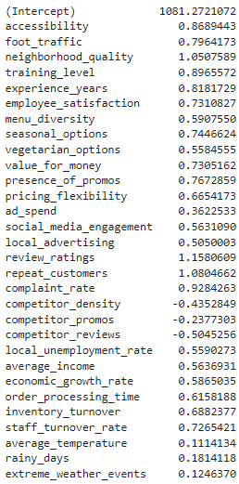
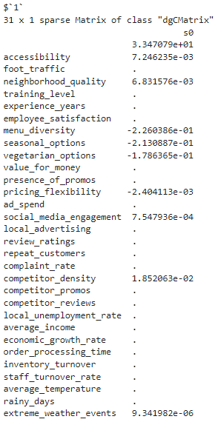
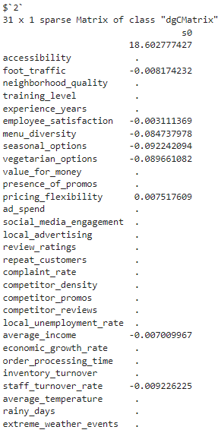
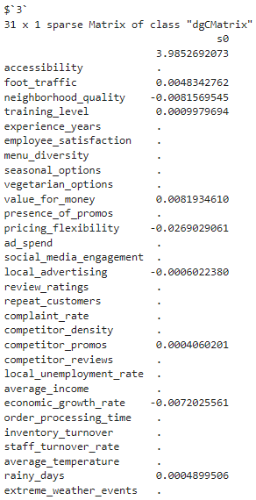
Feature Selection using Regularization
Using regularization, we build a ridge regression model, LASSO regression model and elastic net model. Then, we perform cross validation to get the values of lambda and alpha (for elastic net only) that garner the best performance. The coefficients will then determine which features to keep and to discard.
Elastic Net - Income
Elastic Net - Star Rating
Coefficients
Sample Coefficients
12
NOTE: For predicting the star rating, 5 sets of coefficients are created but only a sample is shown for brevity

Slide 13
Feature Selection using Regularization
The following summarizes the performance of all regularized models:
For Predicting Income (Regression)
Model | Best Model Lambda | Best Model Alpha | Cross Validated RMSE
Ridge Regression | 4.1994636818971 | - | 22.2633976184646
LASSO Regression | 0.173522360074328 | - | 22.5957706026649
Elastic Net | 0.720306558987149 | 0.2 | 22.3129418831851
Findings:
We find that the ridge regression garners the least RMSE; hence, its coefficients will be used as basis for selecting the final features.
From Slide 10, we observed that all of the features were still retained. Thus, we have to use ALL features moving forward for this prediction scenario.
14

Slide 14
Feature Selection using Regularization
The following summarizes the performance of all regularized models:
For Predicting Star Rating (Multi-class Classification)
Model | Best Model Lambda | Best Model Alpha | Cross Validated Accuracy
Ridge Regression | 0.0325170177073424 | - | 0.686
LASSO Regression | 0.00653342651225844 | - | 0.746
Elastic Net | 0.00602685052286242 | 0.9 | 0.748
Findings:
We find that the elastic net model garners the highest accuracy; hence, its coefficients will be used as basis for selecting the final features. Surprisingly, the model is almost a lasso regression model, with alpha = 0.9.
This makes sense since we want to remove unimportant features while still being able to remove collinearity between variables (from using ridge regression as well).
From Slide 12, we observed that some features had their coefficients zeroed out for a certain class. BUT, since this is a multi-class classification problem, if we account for all 5 sets of coefficients (5 classes), we see that we can drop these features: local_unemployment_rate, order_processing_time, complaint_rate, repeat_customers, and experience_years
13

Slide 15
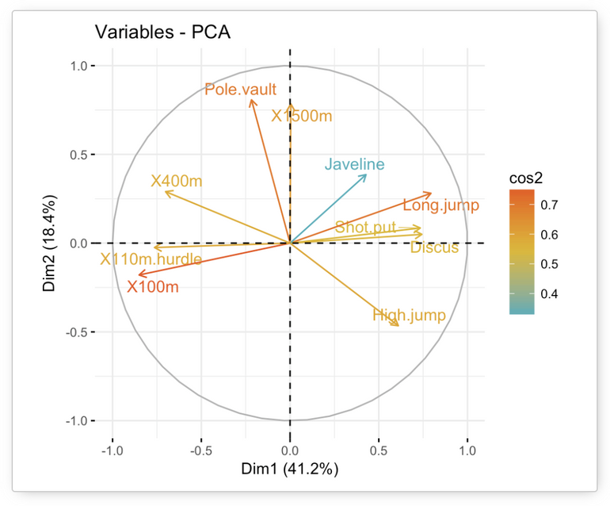
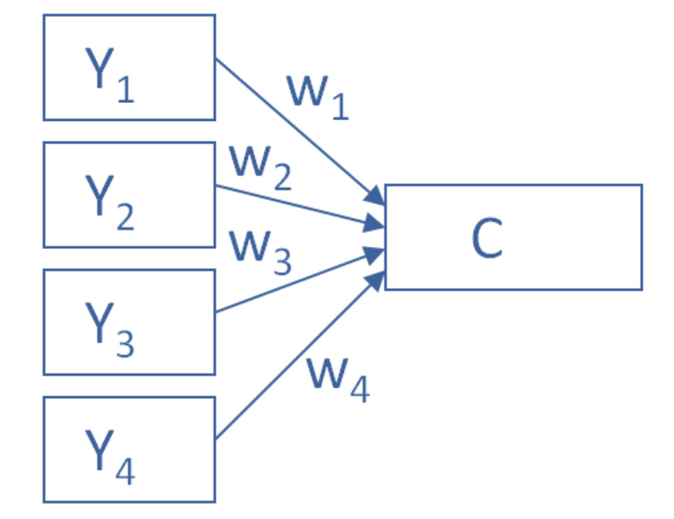
Principal Component Analysis
is used to reduce the number of variables while maintaining the majority of the important information. The main objective of PCA is to simplify your model features into fewer components to help visualize patterns in your data
15

Slide 16
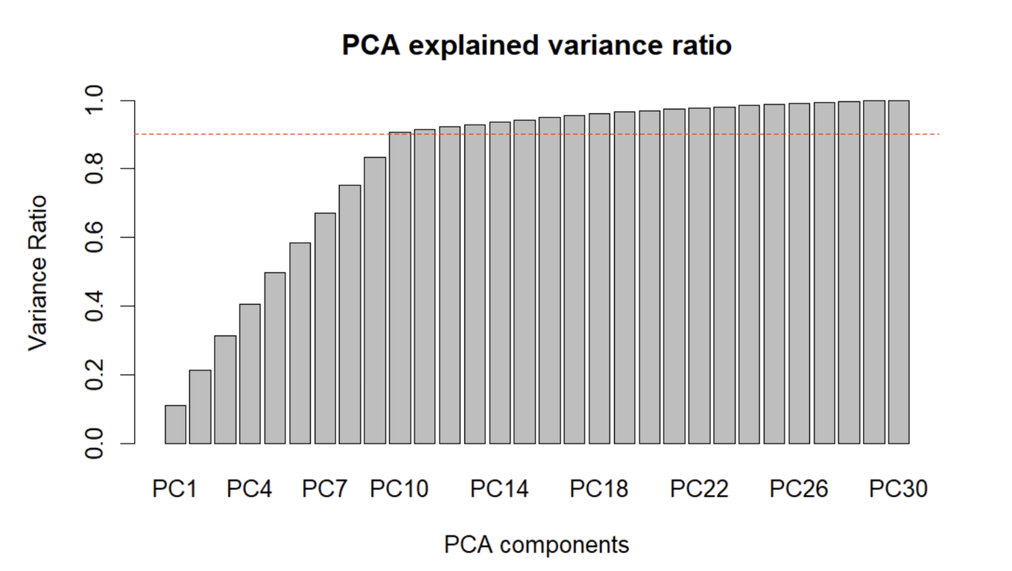
Choosing the Number of Principal Components
Using R’s prcomp() function, it extracted 30 principal components. Cumulative variance ratio is shown below according to its principle components added from left to right.
By the explained variance ratio plot, we decided to use only 10 Principal Components since it already has ~90% variance of the data.
Note: 30 features (excluded income & star rating)
16

Slide 17
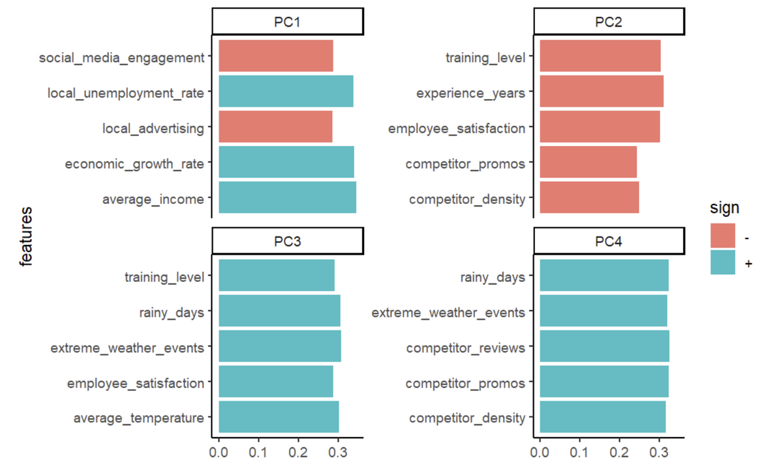
Factor Loadings
Loadings are useful because you can see the importance of each variable across all of the calculated Principal Components. We limit the loadings to their top 5 highest values for interpretability of Factors.
PC1 - In contrast of low values of social media engagement and advertising to high unemployment rate, economic rate, and average income.
PC2 - low values of features related to holistic employment growth and competitor factors.
PC3 - high values of features related to employee growth and weather conditions.
PC4 - high values of features related to competitor factors and weather conditions.
17

Slide 18
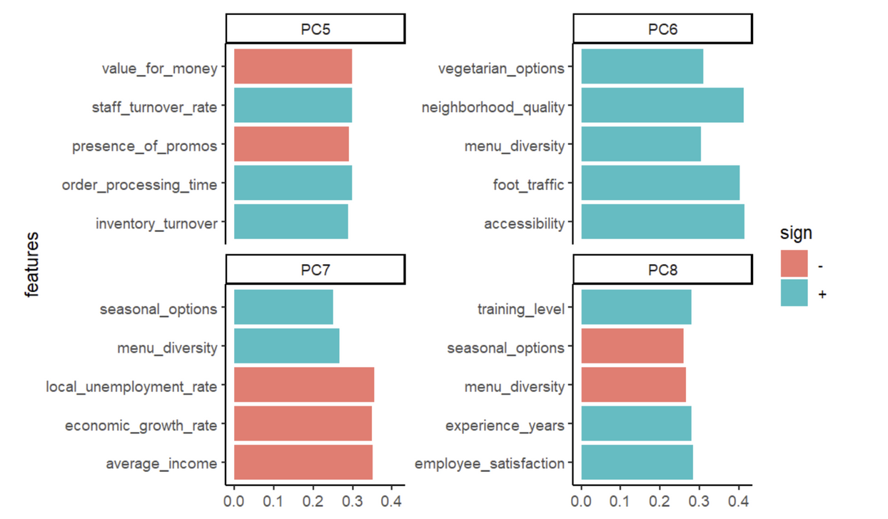
Factor Loadings
PC5 - In contrast of high values for inventory turnover, staff turn over and order processing time to low values of restaurant’s value for money and promos.
PC6 - high values for variety of products (ie. vegetarian) and accessibility.
PC7 - In contrast of low values for unemployment & economic growth rate, and average income to variety of products including seasonality.
PC8 - In contrast of low values of variety of products together with seasonal promos to high employee satisfactory performance/growth.
18

Slide 19
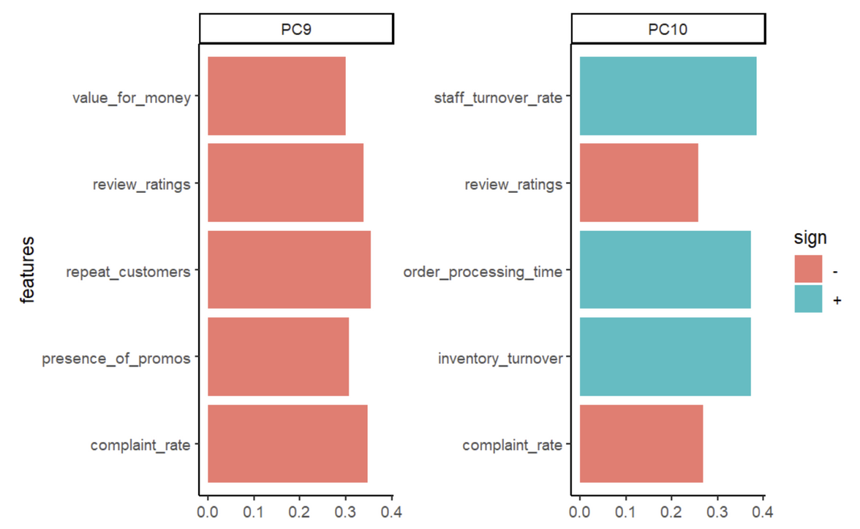
Factor Loadings
PC9 - low values of restaurant strategy, value and customer satisfaction
PC10 - In contrast of high values of inventory/food order time to low customer satisfaction.
19

Slide 20
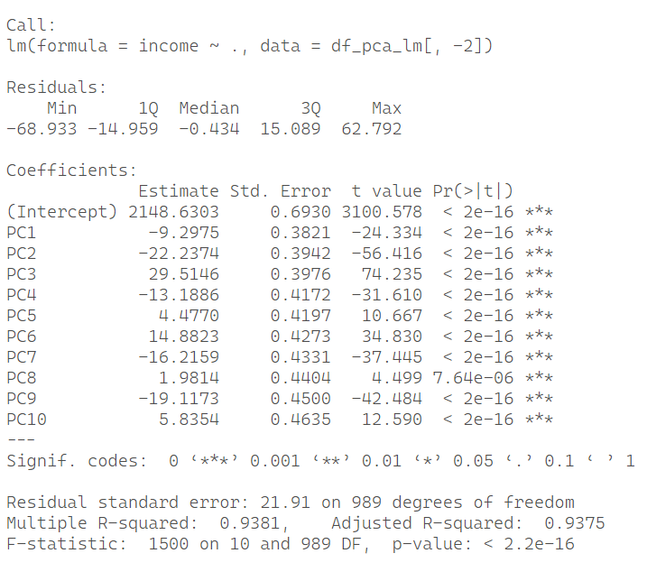

Association of Factors with Income & Rating
Now, we interpret each Principal component’s association to income or rating
by using Linear & Logistic Regression
Income
PC3, relating to employee growth and weather conditions, has the most significant positive impact on the restaurant's income. PC6, associated with the variety of products and accessibility, also significantly boosts income, making these two principal components the largest contributors to average income growth.
PC2 and PC4, related to poor employee growth, competitor factors, and extreme weather events, significantly contribute to decreasing the restaurant's income. Similarly, PC7 and PC9, associated with low economic growth, poor restaurant strategy, and customer satisfaction, also have a substantial negative impact on income.
20

Slide 21
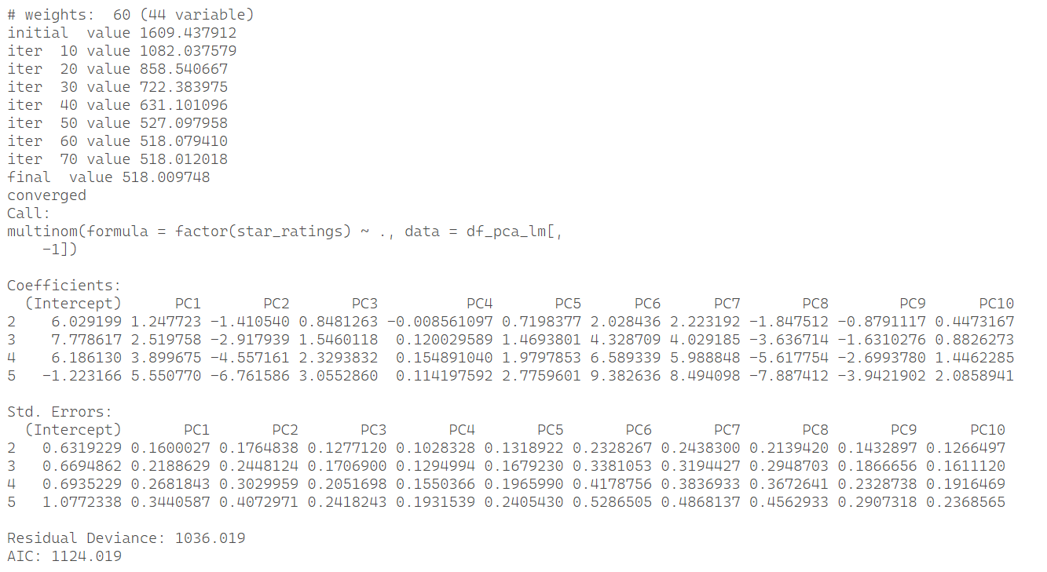
Association of Factors with Income & Rating
Rating
PC6 and PC7 which relates to high values of for restaurant’s
variety of menu/products (i.e. vegetarian) and accessibility gives
a large impact on classifying rating performance of the Restaurant.
21

Slide 22

Model Options
Models that are best used for high-dimensional datasets
for Classification and Regression
Gradient Boosted Trees
Support Vector Machines
Regularized Regression (L1,L2, Elastic Net)
Neural Networks
Principal Component Regression
22

Slide 23
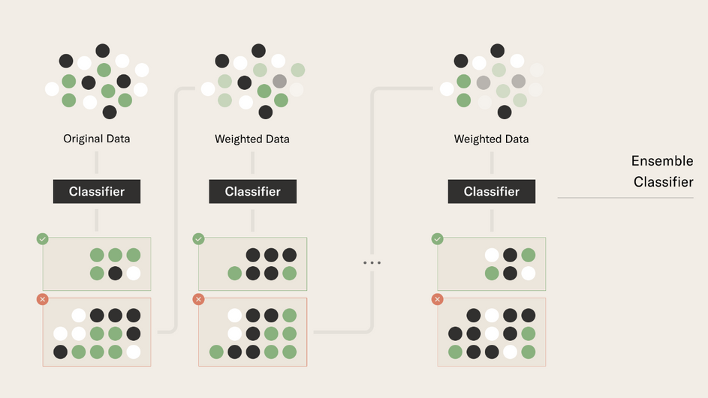
Model Building | Gradient Boosted Trees
Note: Cross-validation (Kfold = 5) was used together with a search for the best parameters for Gradient Boosted Trees model
Income
Upon searching the best parameter’s for GBM regression, RMSE was used to select the optimal model using the smallest value.
The final values used for the model were n.trees = 150, interaction.depth = 5, shrinkage = 0.1 and n.minobsinnode = 10.
RMSE = PHP 31.1169
R-squared = 0.8788
Gradient Boosted Tress Figure.
Star Rating
All Features
Reduced Features
Accuracy was used to select the optimal model using the largest value. The final values used for the model were n.trees = 80, interaction.depth = 9, shrinkage = 0.05 and n.minobsinnode = 10.
Accuracy = 72.90%
Accuracy was used to select the optimal model using the largest value. The final values used for the model were n.trees = 80, interaction.depth = 7, shrinkage = 0.05 and n.minobsinnode = 10.
Accuracy = 73.51%
23

Slide 24
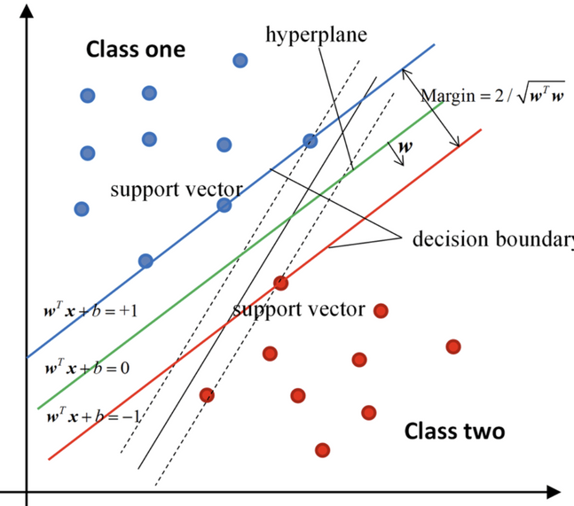
Model Building | Support Vector Machines
Note: Cross-validation (Kfold = 5) was used together with a search for the best parameter for SVM
Linear Kernel was used since the number of features is large and the data
is linearly separable
Income
RMSE was used to select the optimal model using the smallest value. The final value used for the model was C = 1.714714.
RMSE = PHP 22.43513
R-squared = 0.9344
Star Rating
Support Vector Machine Figure.
Accuracy was used to select the optimal model using the largest value. The final value used for the model were C = 0.8578571 for all features used while C = 0.4294286 for reduced features.
Accuracy = 73.79% (All Features), 73.51% (Reduced Features)
SVM gave us a slightly better performance compared to Gradient Boosted Trees
24

Slide 25
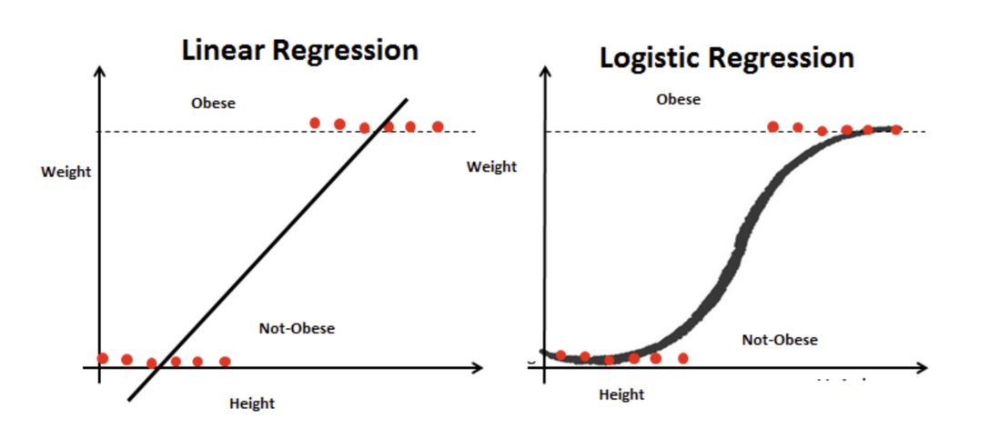
Model Building | Principal Components Regression
Note: Cross-validation (Kfold = 5) was used
Using Principal Components produced in PCA earlier as model features for a Linear/Logistic Regression model
Income
All Principal Components in the fitted Linear Regression model are statistically significant having cross-validated values
RMSE = PHP 21.9319
R-squared = 0.9373
Star Rating
Principal Components in the fitted multinomial Logistic Regression model gave us Accuracy = 74.2
Principal Components Regression gave us a better performance in predicting income and rating than SVM and Gradient Boosted Trees
Linear and Logistic Regression model figure.
24

Slide 26

Model Building | Neural Networks
Note: Cross-validation (Kfold = 5) was used together with a search for the best hyperparameters for Neural Networks
Hyperparameter optimization was performed by either changing the number of neurons per hidden layer (width), the number of hidden layers (depth), and the activation function applied to all hidden layers.
Income
RMSE was used to select the optimal model using the smallest value. The final set of hyperparameters used were: number of neurons = 1,000 , number of hidden layers = 4, activation function for all hidden layers = sigmoid using the reduced feature set
RMSE = PHP 1,644.18
Star Rating
Accuracy was used to select the optimal model using the largest value. The final set of hyperparameters used were: number of neurons = 500, number of hidden layers = 3 , activation function for all hidden layers = tanh using the principal components
Accuracy = 74.1%%
Neural Networks Figure.
The neural networks were observed to have relatively good performance for predicting star rating but had the worst performance for predicting income.
25

Slide 27
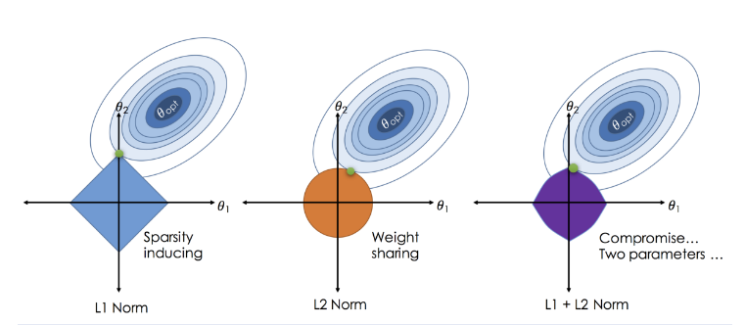
Model Building | Regularized Regression
Note: Cross-validation (Kfold = 5) was used together with a search for the best hyperparameters for the regularized regression models
Hyperparameter optimization was performed by either changing the lambda and alpha (for elastic net).
Income
RMSE was used to select the optimal model using the smallest value. The lambda of the best model, which was a ridge regression model, was equal to 4.1994636818971
RMSE = PHP 22.2634
Star Rating
Accuracy, via misclassification error, was used to select the optimal model using the largest value. The final set of hyperparameters, which were fitted to an elastic net model, were: lambda = 0.00602685052286242 , alpha = 0.9
Accuracy = 74.8%
Regularized Regression Figure.
The regularized models seem to provide the best performance in predicting the star rating of a restaurant.
26

Slide 28
Best Model
Income
Rating
Model | RMSE (PHP)
GBM | 31.116﻿9
SVM | 22.43513
Principal Components Regression | 21﻿.9319
Neural Networks | 1,644.18
Regularized Regression | 22.2634
Model | Accuracy
GBM | 73.51%
SVM | 73.79%
Principal Components Regression | 74.2%
Neural Networks | 74.1%
Regularized Regression | 74.8%

Slide 29
Conclusion
Predicting Income
Although the performance of SVM and regularized regression on high-dimensional data is great, Principal Components Regression stands out as the best. Given our high-dimensional data, Principal Components Analysis (PCA) simplifies our features into fewer components while maintaining important information. By reducing the principal components to 10, we still retain 90% of the variance. PCA also helps reduce overfitting and addresses multicollinearity, which may be present in the observed variables that are linearly correlated. Incorporating these components into a Linear Regression model gave us the best performance in RMSE.
Predicting Rating
All of the compared models fared pretty well, but the Regularized Regression Model had the best fit (by a hair). This might be because of the use of a high alpha (0.9), which made sure to retain the most impactful features and discard the rest (per class). Despite using an alpha that may resemble the behavior of a LASSO regression model, which has an issue of still retaining correlated features, the elastic model still employed some ridge regression to prevent collinearity. Overall, it seems that all models were able to generalize well by using the reduced feature set. This highlights how important it is to first perform feature selection before the actual model training to ensure that we use features that have some relationship with the target variable and not incorporate features that might just confuse the model by being noisy, which can decrease its predictive potential.

Slide 30
Thank you!

